Slide 1
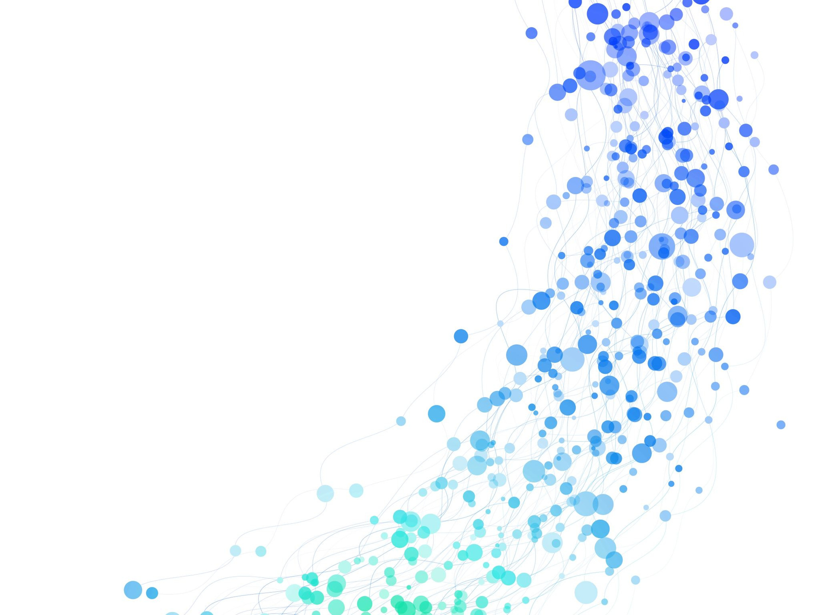


LIFE SKILLS
EDUCATION INITIATIVE FOR INTERNALLY DISPLACED PERSONS’ (LIID) IN TWO IDP CAMPS IN FCT ABUJA
Presented by:
Olakehinde Abdullahi .O

Slide 2

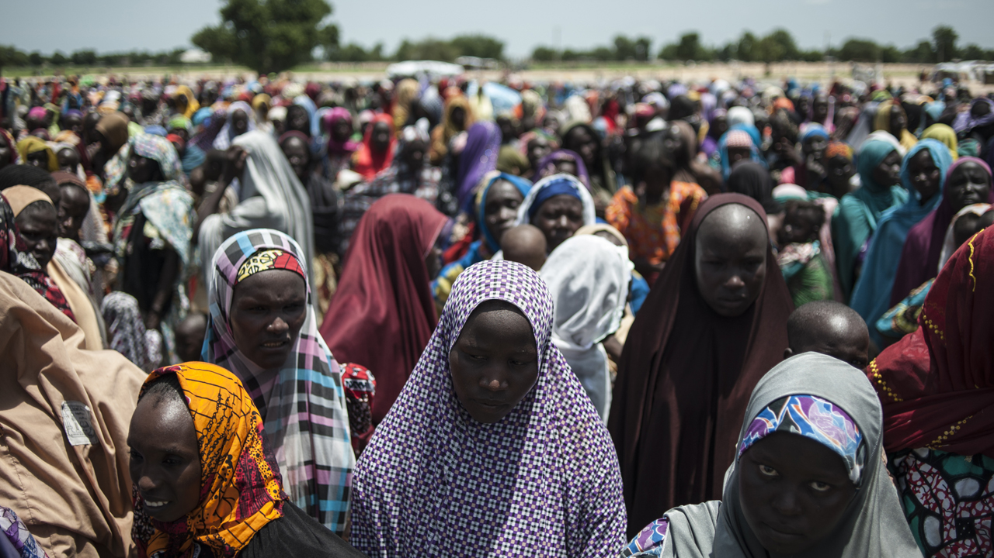


LSE ABUJA
INTRODUCTION
The humanitarian crisis in Nigeria, marked by the displacement of millions due to insurgency and communal conflicts, has resulted in a significant rise in Internally Displaced Persons (IDPs). In Abuja's Federal Capital Territory (FCT), many IDPs reside in camps with limited access to essential needs like shelter, food, and education.
Life Skills Education (LSE) has emerged as a critical initiative to empower these vulnerable populations by providing essential skills for survival, self-reliance, and psychosocial well-being. This program is especially important for IDPs, as it helps them cope with trauma, adjust to their new circumstances, and reintegrate into society. By focusing on practical life skills, LSE aims to enhance the quality of life for IDPs and reduce aid dependence.
1
Source: UNICEF, 2020; UNHCR, 2021

Slide 3


AIM AND OBJECTIVES
LSE ABUJA
The aim of this study is to empower IDPs in FCT, Abuja, by enhancing their access to humanitarian services and promoting sustainable integration into host communities through Life Skills Education (LSE), focusing on psychosocial well-being, coping abilities, and integration skills. The specific objectives are to:
Co-design and implement a culturally adapted LSE intervention curriculum with IDP communities and local stakeholders in Nigeria
Evaluate the effectiveness of a culturally adapted LSE intervention in improving mental health and psychosocial outcomes among IDPs
Compare the implementation outcomes of in-person vs. Mobile (WhatsApp) facilitated delivery models for the LSE intervention
2

Slide 4



METHODOLOGY
LSE ABUJA
Last Period
Recent Period
Data Collection:
Data were gathered by Brooks Insights using an LSE self-efficacy tool to assess IDPs' self-reported efficacy on 12 life skills. Implementation outcomes were measured using the Acceptability of Intervention Measure (AIM) and the Intervention Appropriateness Measure (IAM).
Analysis:
Mixed-effects linear regression was employed to evaluate the effectiveness of LSE in improving mental health and psychosocial well-being based on AIM and IAM .The Models use the LSE as the fixed effects and the camp names as the random effects.
Last Period
Recent Period
Indicators
% Change
Multicollinearity Adjustment:
Due to the detection of multicollinearity among 3 of the 12 LSE domains —National Purpose, Cooperation, and Respect for Diversity—These LSE domains were excluded from the analysis.
Software Tools:
Data cleaning: tidyr, dplyr, and tidyverse in R.
Visualization: ggplot2.
Linear mixed-effects modeling: lmer in R.
Statistical analysis: Conducted using R software
% Change
Global Outlook (IMF, WE3)
Global Outlook (IMF, WE3)
3

Slide 5
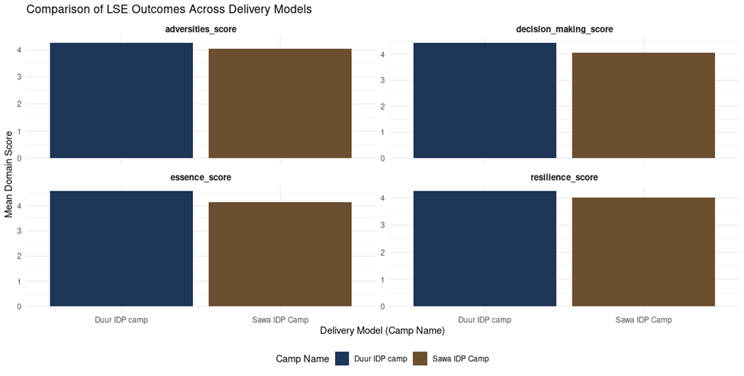
COMPARISON OF LSE OUTCOMES ACROSS DELIVERY MODELS
LSE ABUJA
Fig. 1 compares the in-person delivery model at Duur Camp and the mobile model at Sawa Camp for life skills education. While both models were well-received, in-person delivery at Duur Camp was slightly more preferred, with minimal differences observed between the two formats. The selected skills included dealing with adversities, decision-making, essence, and resilience.
Fig. 1
4

Slide 6
MODEL SUMMARY 1 (AIM)
LSE ABUJA
The AIM model highlights the effectiveness of Life Skills Education (LSE) factors in enhancing psychosocial outcomes among IDPs. Dealing with Adversities (β = 0.23), Resilience (β = 0.21), and National Identity (β = 0.22) are strong predictors, with Essence (β = 0.19) showing a moderate positive effect. Conversely, Creativity, Critical Thinking, Problem Solving, Negotiation, and Decision Making (β ≈ 0) exhibit negligible effects. These results emphasize prioritizing Dealing with Adversities, Resilience, and National Identity in the LSE curriculum to maximize psychosocial impact.
Indicators
Last Period
Recent Period
% Change
Indicators
Fixed Effects | (β) Estimate | Std.Error | Lower interval (2.5%) | Upper interval (97.5%)
(Intercept) | 4.201E+00 | 1.478E-16 | -
Essence | 1.912E-01 | 1.936E-16 | - | 1.911691E-01
Dealing with adversities | 2.270E-01 | 2.444E-16 | - | 2.270350E-01
Resilience | 2.111E-01 | 2.117E-16 | - | 2.110802E-01
National Identity | 2.183E-01 | 1.921E-16 | - | 2.182676E-01
Creativity | -1.813E-16 | 2.419E-16 | -2.100607E-08 | 2.100607E-08
Critical Thinking | 4.007E-16 | 2.016E-16 | -2.090813E-08 | 2.090813E-08
Problem Solving | -7.062E-16 | 2.322E-16 | -2.098396E-08 | 2.098396E-08
Negotiation | -9.856E-16 | 2.253E-16 | -2.096767E-08 | 2.096767E-08
Decision making | 1.516E-15 | 2.420E-16 | -2.100638E-08 | 2.100638E-08
5

Slide 7
MODEL SUMMARY II (IAM)
LSE ABUJA
The IAM model demonstrates the relative effectiveness of LSE intervention factors on mental health and psychosocial well-being among IDPs. National Identity (β = 0.13), Creativity (β = 0.26), and Critical Thinking (β = 0.25) are strong predictors, contributing significantly to improved IAM outcomes. Problem Solving (β = 0.08) shows a moderate effect, while factors such as Essence (β = 0.001), Negotiation (β = 0.008), and Decision Making (β = 0.009) exhibit negligible contributions. Dealing with Adversities and Resilience have minimal impact. The results emphasize prioritizing Creativity, Critical Thinking, and National Identity in the LSE curriculum for optimal psychosocial impact.
Indicators
Last Period
Recent Period
% Change
Indicators
Fixed Effects | (β) Estimate | Std.Error | Lower interval (2.5%) | Upper interval (97.5%)
(Intercept) | 4.301775 | 0.025151 | 4.24197955 | 4.36044464
Essence | 0.001533 | 0.016555 | -0.03396106 | 0.03188649
Dealing with adversities | -0.024048 | 0.020554 | -0.06236166 | 0.01769980
Resilience | 0.009676 | 0.017706 | -0.02526401 | 0.04319799
National Identity | 0.125807 | 0.016080 | 0.09545399 | 0.15768551
Creativity | 0.262546 | 0.020232 | 0.22268485 | 0.30089168
Critical Thinking | 0.246184 | 0.016890 | 0.21441568 | 0.27986824
Problem Solving | 0.080374 | 0.019395 | 0.04268043 | 0.11752303
Negotiation | 0.080374 | 0.018821 | -0.01830418 | 0.05434274
Decision making | 0.009036 | 0.020291 | -0.03151983 | 0.04715475
6

Slide 8
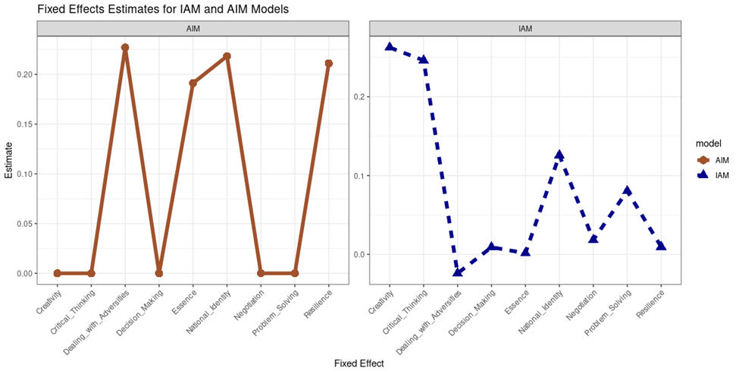
FIXED EFFECT ESTIMATES FOR IAM AND AIM MODELS
LSE ABUJA
Figure 2 compares the fixed effects estimates for the AIM and IAM models, illustrating the effectiveness of LSE factors on mental health and psychosocial well-being among IDPs. The AIM model highlights Dealing with Adversities, National Identity, and Resilience as key contributors, with moderate support from Essence, while Creativity and Critical Thinking show negligible effects. Conversely, the IAM model emphasizes Creativity, Critical Thinking, and National Identity, with moderate contributions from Problem Solving. National Identity stands out as a common strong predictor across both models. These findings underline distinct focus areas for optimizing LSE interventions.
Fig. 2
7

Slide 9
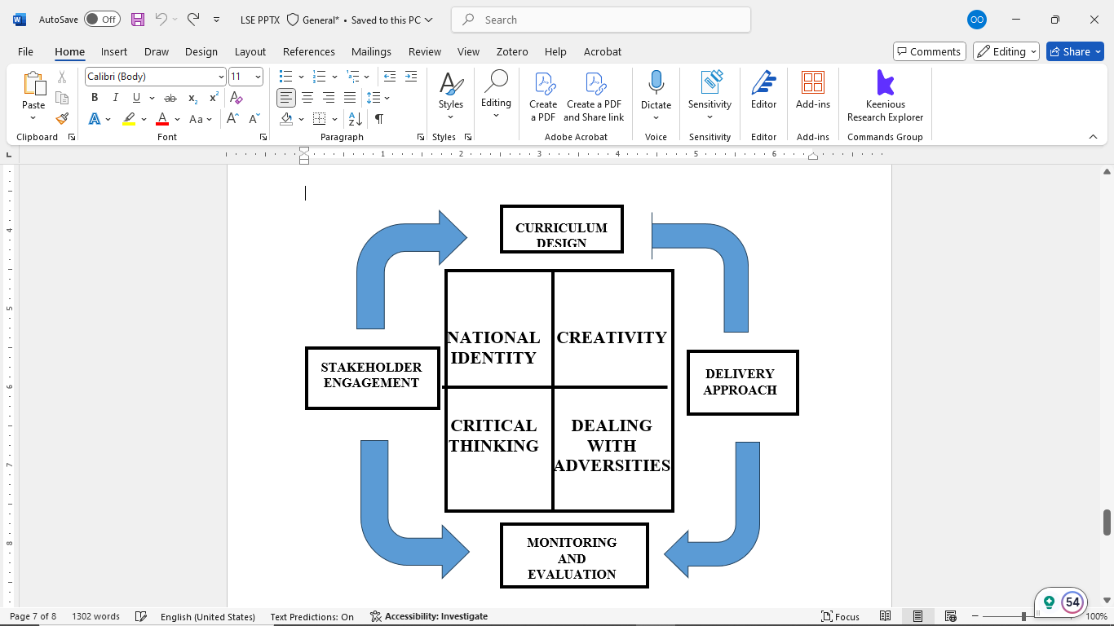
CONCLUSION AND RECOMMENDATIONS
LSE ABUJA
Conclusion:
The Life Skills Education (LSE) program in IDP camps in Abuja has positively impacted the mental health and well-being of participants. Key skills like Dealing with Adversities, Resilience, and National Identity were the most effective in improving psychosocial outcomes. Skills such as Creativity and Critical Thinking had limited effects.
Recommendation:
Prioritize in-person LSE delivery , though mobile options should be available for wider reach.
Integrate Creativity and Critical Thinking more effectively to enhance overall outcomes.
Indicators
Designed culturally adapted LSE intervention
8

Slide 10
THANK YOU

